Slide 1




Tatiana Asadourian
Dr. Maitrayee Bose, Lucas Reynoso | ASU School of Earth & Space Exploration
Arizona NASA Space Grant Statewide Symposium
Arizona State University | April 19, 2025
Changes in pH During Glycine Entrainment in Halite Crystals:
A Ceres Analogue
[1]

Slide 2
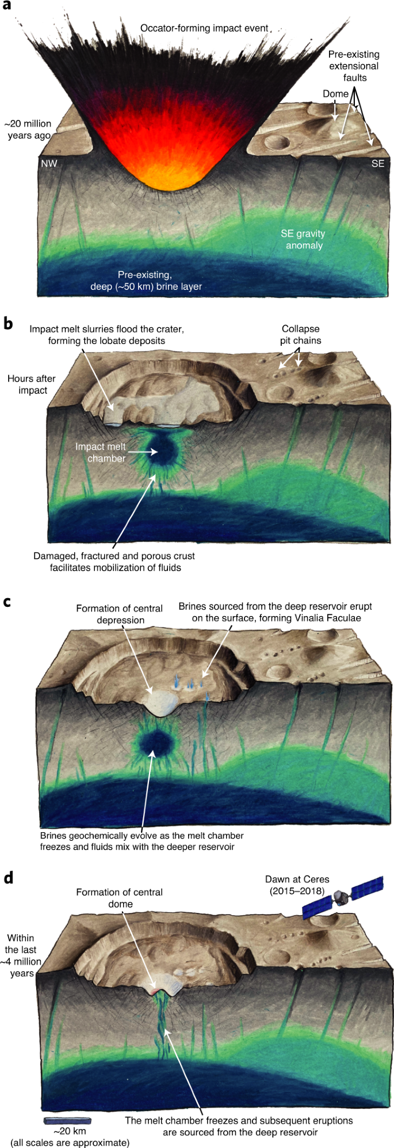

Background
What makes up Ceres’ environment?
Could organic molecules be preserved in icy/oceanic environments?
Are bodies like Ceres suitable for prebiotic chemistry?
How does entrapment of organic material affect pH, and vice versa?
Figure 1: Formation of melt chamber on Ceres and resulting mobilization of fluids with organic material [2].
2

Slide 3
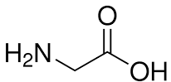
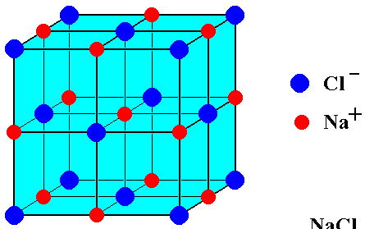
Objectives
Develop experiment using Ceres analogue minerals to replicate process of salts mixing with organic material on Ceres’ surface
Track pH of solutions and observe entrapment of organic material in salt crystals through microscopic imaging
Why glycine? Why halite (NaCl) crystals?
Glycine = simplest amino acid
- Detected in Ceres’ salt deposits by NASA’s Dawn spacecraft [3]
NaCl = simple salt with easy growth conditions
- Provides broad insight into interactions between organics and salts
Figure 2: Structural Formula
of Glycine [4]
Figure 3: Unit Cell of NaCl [5]
3

Slide 4
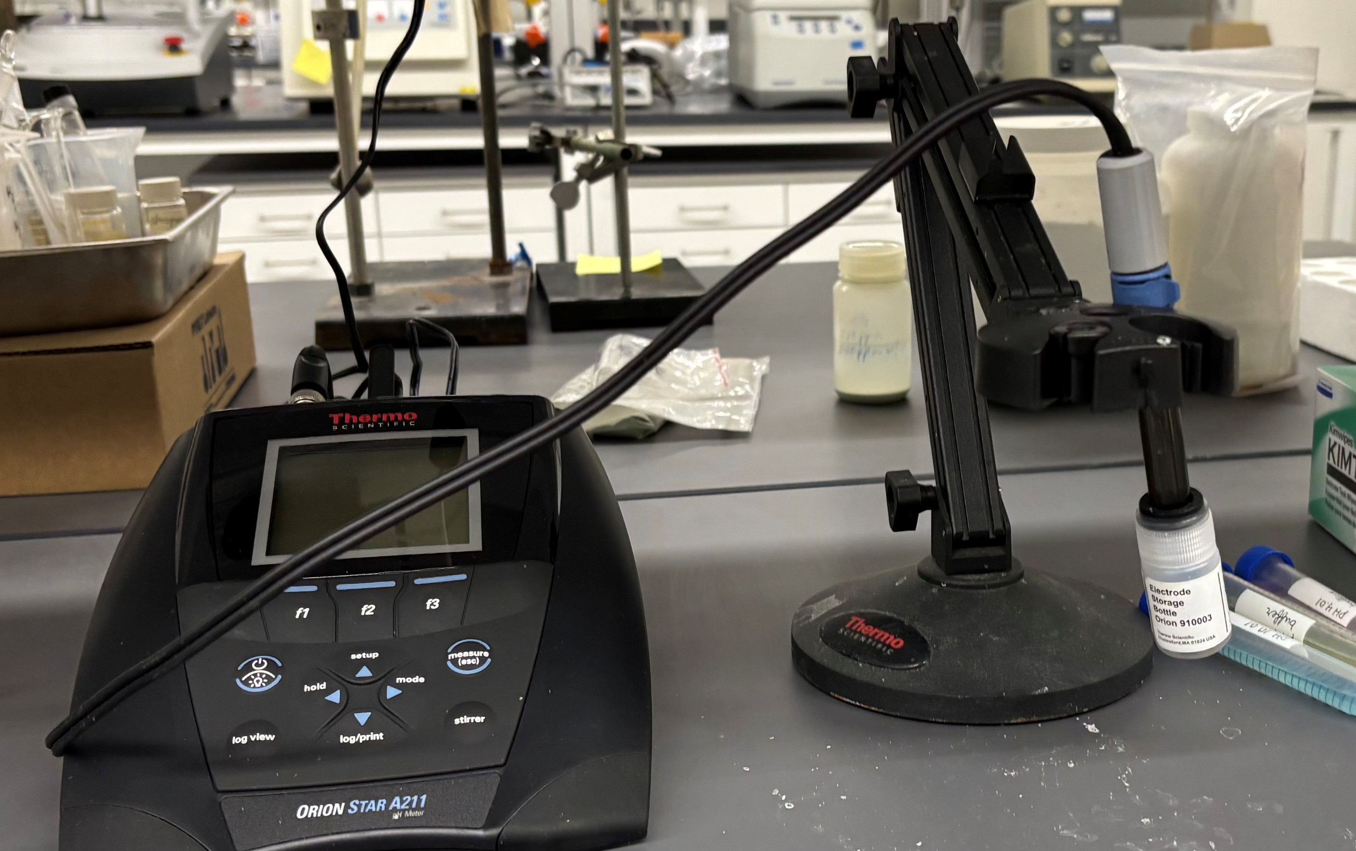
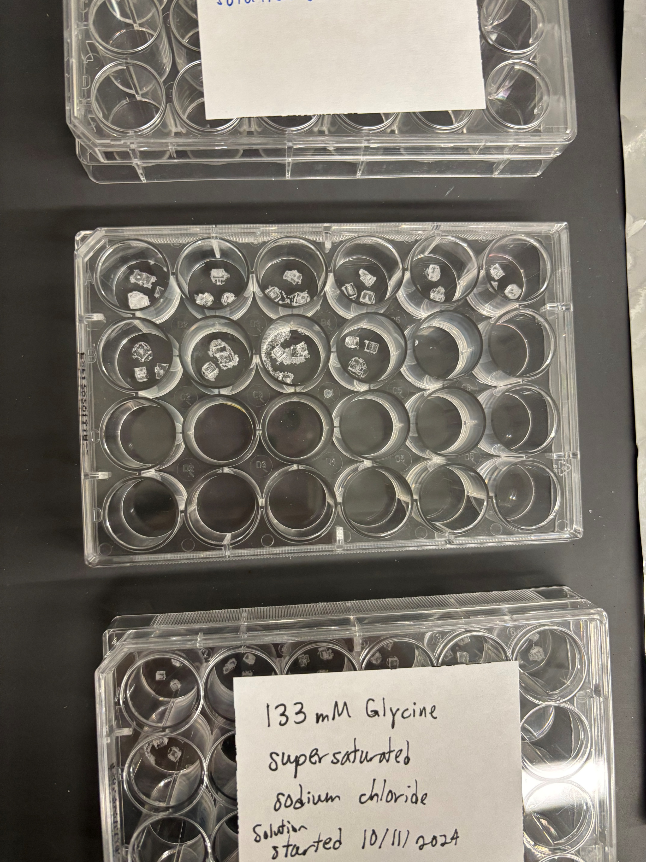
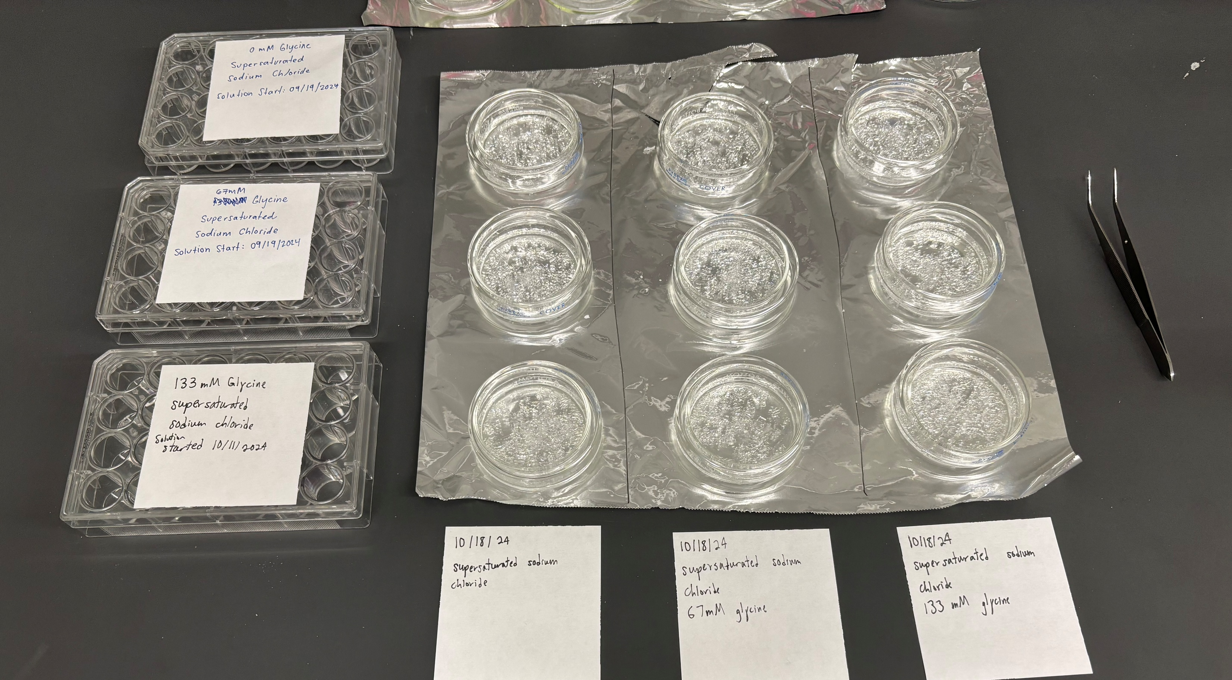
Methods
3 supersaturated NaCl solutions with varying glycine concentrations
pH & temperature measured twice a week with
pH meter
After 1 week of growth, 3 largest crystals from each solution were collected biweekly as well
Completed microscopic imaging
Figure 4: Laboratory set-up with pH meter and probe; Petri dishes with crystals in solution; sample collector grids with biweekly collected crystals.
4

Slide 5
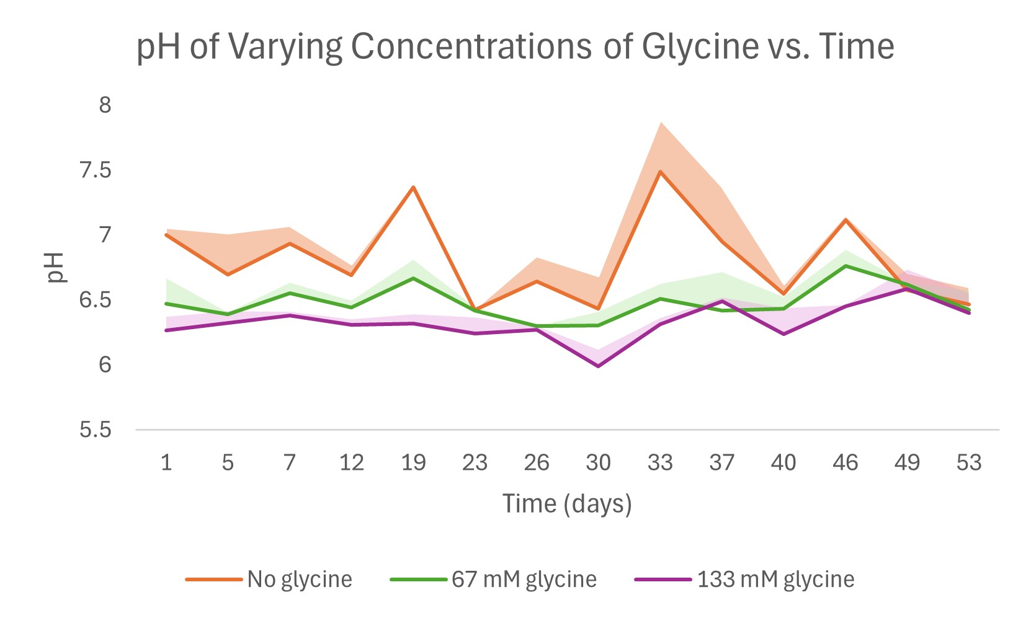
Results
pH consistently higher for solutions with less/no glycine
133 mM glycine line suggests potential increase in pH over time
Solution becomes less acidic as glycine is entrapped in salt crystal
Figure 5: pH of solutions with higher concentration of glycine is more acidic, consistent with glycine’s nature as an amino acid
5

Slide 6
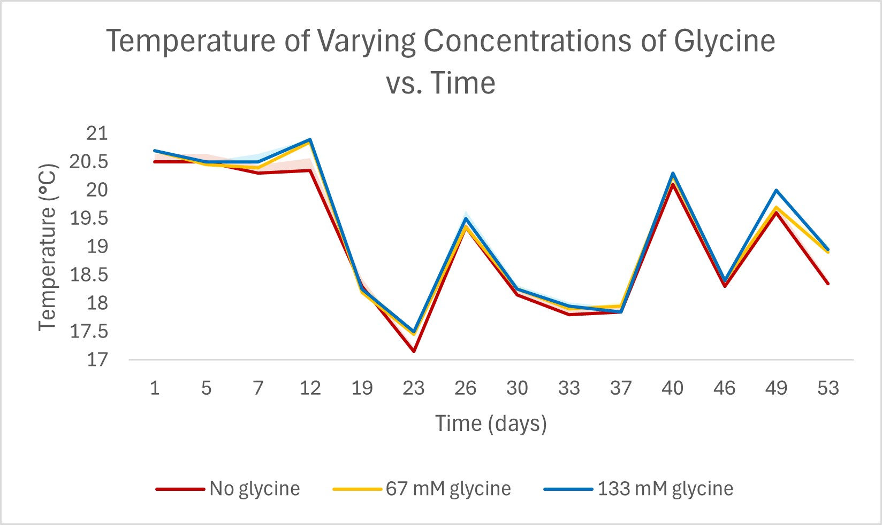
Results cont.
Temperature measured by pH probe reflects ambient temp. of lab
Does not reflect temp. of solution
Consistent temp. between measurements on same day confirms pH results are reliable
Figure 6: Temperatures of solutions on a given day do not vary by over 0.5˚C, indicating that pH measurements are reliable and consistent
6

Slide 7
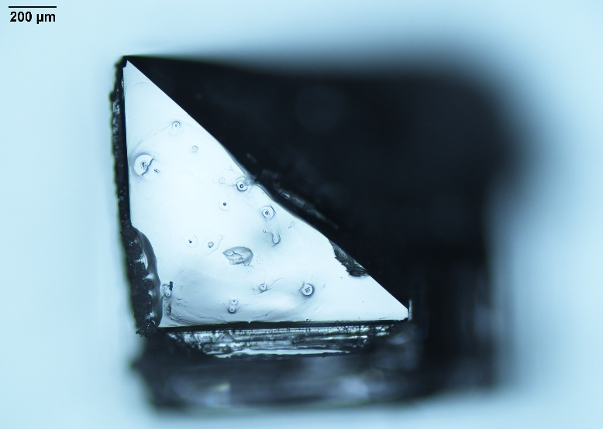
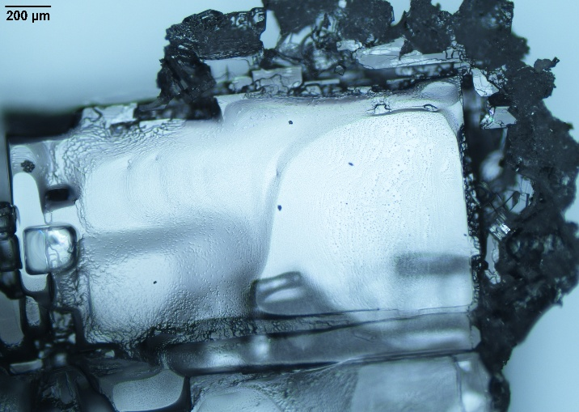
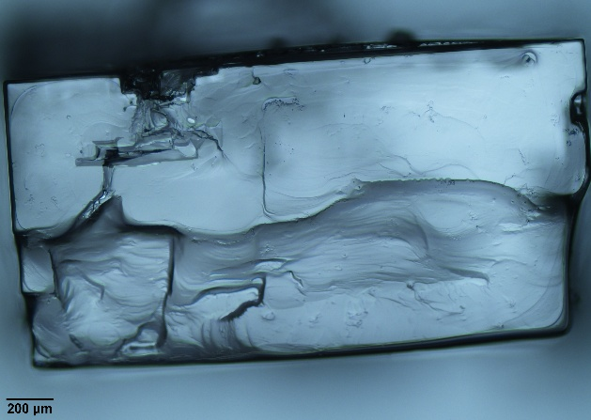
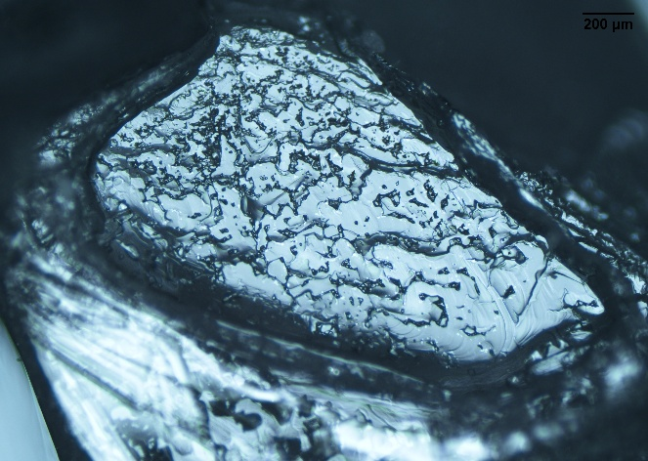
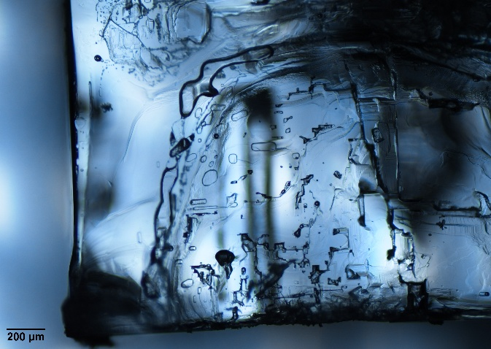
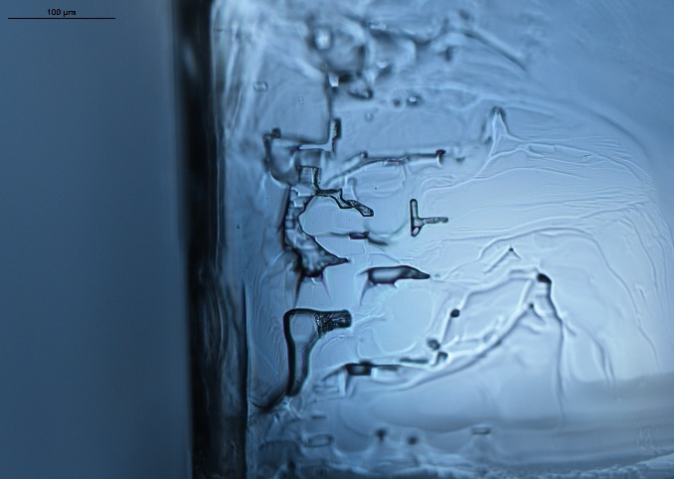
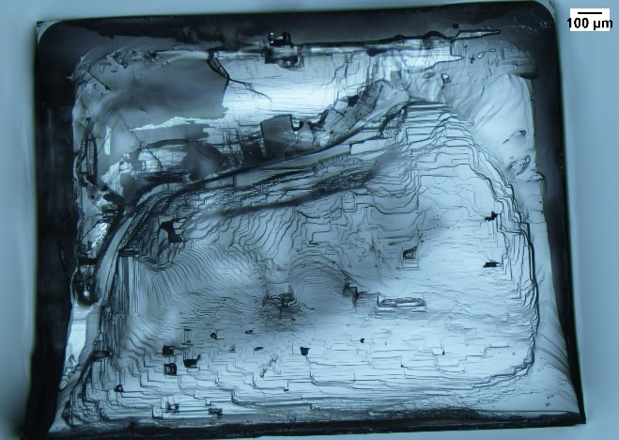
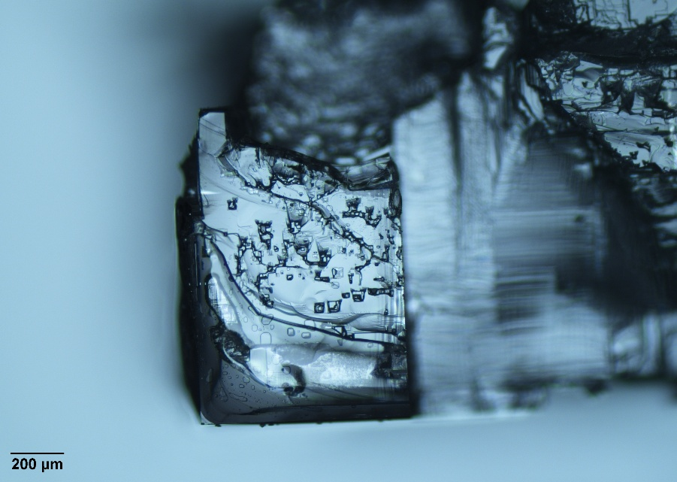
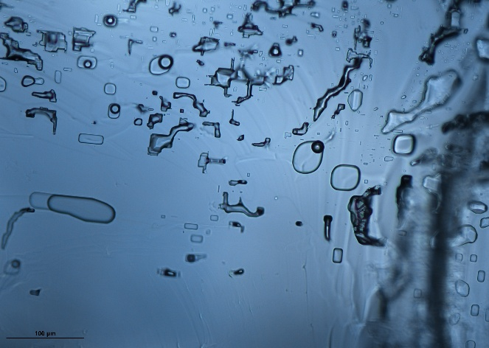
Beginning Middle End
Results cont.
No glycine
Microscopic imaging of crystals from beginning, middle, & end of sample collection
67 mM & 133 Mm glycine samples demonstrate glycine entrapment through inclusions & dark spots
67 mM glycine
133 mM glycine
7
Figure 7: Microscopic imaging of crystals from each solution; glycine inclusions evident in 67 & 133 mM

Slide 8
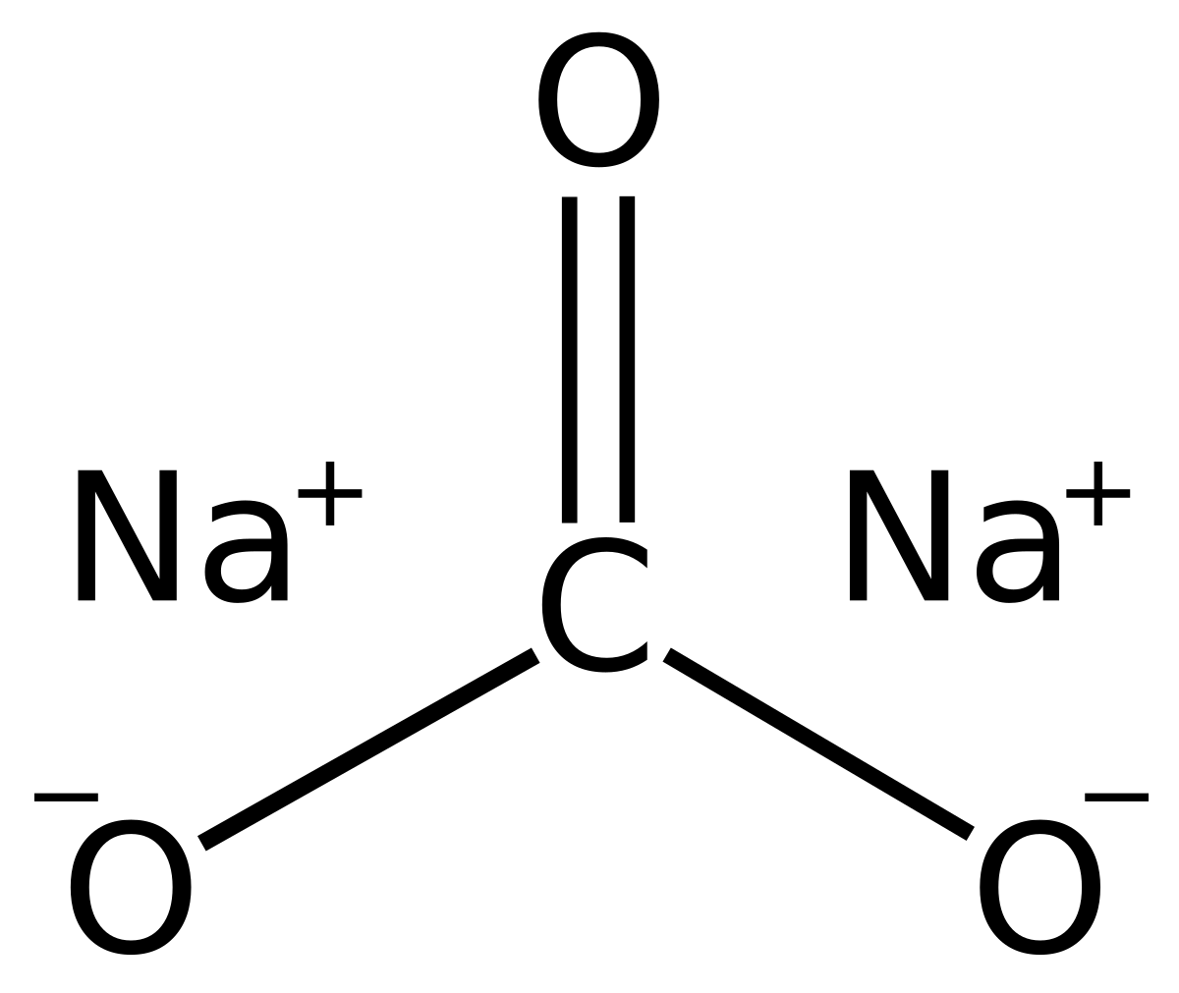
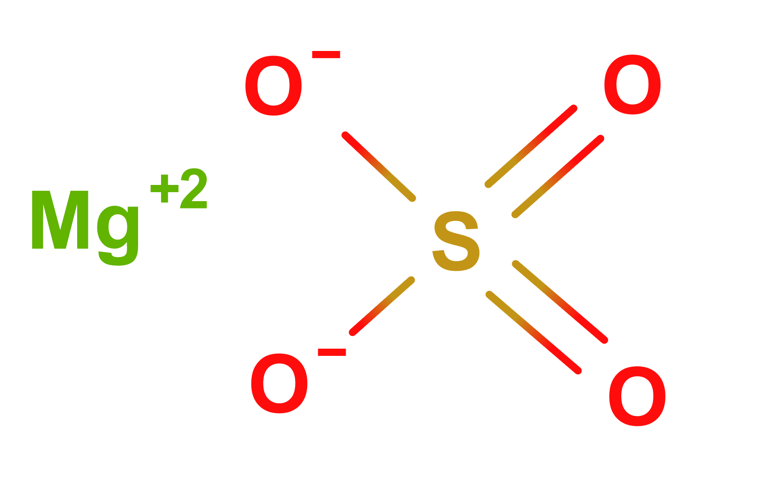
Conclusion & Future Work
Microscopic imaging confirms successful entrapment of glycine
Trend of pH over time is not definitive; slight increase as glycine is entrapped in crystal
Requires further investigation of potential for Ceres & similar environments to sustain organic material
Where do we go from here?
Conduct similar experiment with different organics and substrates to better interpret effect of pH changes
Need complex methods of analysis & better control of variables such as temperature to yield more accurate results
Figure 8: Structural formula of sodium carbonate (left) [6] a type of salt detected on Ceres by Dawn. [3]
Figure 9: Structural formula of magnesium sulfate (right) [7], another abundant salt on Ceres.
8

Slide 9
Acknowledgements
I would like to thank Dr. Maitrayee Bose for her immense patience and guidance, as well as Lucas Reynoso for his knowledge and constant support. I’d also like to thank the Arizona Space Grant Consortium, as well as the ASU/NASA Space Grant program and its directors, Desiree Crawl and Dr. Tom Sharp, for the opportunity to complete this research project.
9

Slide 10



Thank you!
10

Slide 11
References
[1] Ceres: a bright spot in planetary exploration. Image Credit: NASA/JPL-Caltech/UCLA/MPS/DLR/IDA
[2] Raymond, C.A., Ermakov, A.I., Castillo-Rogez, J.C. et al. Impact-driven mobilization of deep crustal brines on dwarf planet Ceres. Nat Astron 4, 741–747 (2020).
[3] De Sanctis, M. C. et al. Localized aliphatic organic material on the surface of Ceres. Science (New York, N.Y.) vol. 355,6326 (2017): 719-722.
[4] Structural Formula of Glycine. Image Credit: https://www.mpbio.com/au/glycine-98
[5] Unit Cell of NaCl. Image Credit: https://chemistry.stackexchange.com/questions/34119/number-of-atoms-in-nacl-unit-cell
[6] Structural Formula of Sodium Carbonate. Image Credit: https://en.wikipedia.org/wiki/Sodium_carbonate
[7] Structural Formula of Magnesium Sulfate. Image Credit: https://inci.guide/inorganic-compounds/magnesium-sulfate
11

